Slide 1
AURA Meeting
Wednesday, July 22,2015

Slide 2
Welcome
Amaris Ogu, MBA
Supervisor, Systems & Reporting
Sponsored Projects Administration

Slide 3
Housekeeping Items
ITV Groups
Please mute microphones
Presenters
Repeat questions in mic

Slide 4
Website Spotlight
Troy Roberson
Systems & Reporting Specialist
Sponsored Projects Administration

Slide 5
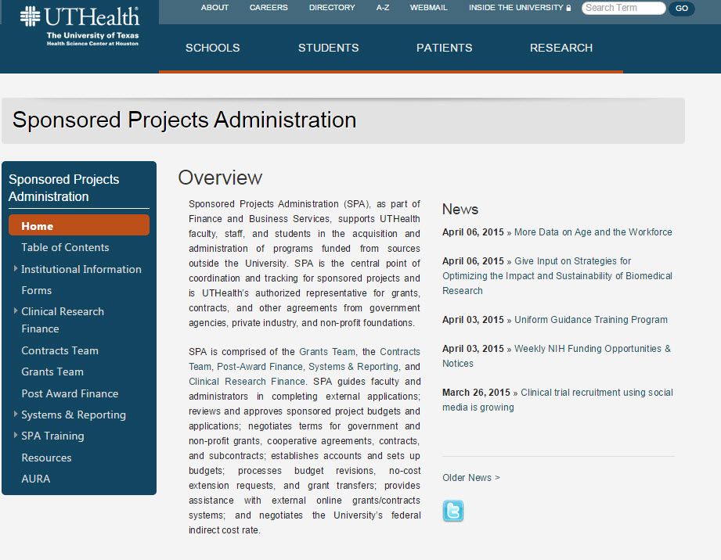
Website Spotlight

Slide 6
Effort Reporting
Amaris Ogu, MBA
Supervisor, Systems & Reporting
Sponsored Projects Administation

Slide 7
Effort Reporting Dates
Certification Period:
Tuesday, July 21st – Friday, August 21st
Travel restrictions on uncertified cards: Monday, August 24th

Slide 8
Effort Reporting Reminders
Please review all cards for accuracy
Initiate Personnel Actions, if needed
Place incorrect cards on hold until fixed
Make adjustments for Cost Sharing (CPRIT)
Guides and forms on Effort website

Slide 9
SPA Training Program
Amaris Ogu
Supervisor, Systems & Reporting
Sponsored Projects Administration

Slide 10
SPA Training Program
Tues., Oct. 27th – Thurs., Oct. 29th 8:30 a.m. – 4:30 p.m. each day
$160 for all three days
Register at go.uth.edu/SPAregister
For more information go to go.uth.edu/SPATraining
or email spatraining@uth.tmc.edu

Slide 11
SPA Training Program: New Online Modules Available
Available Modules:
Effort Certification at UTHealth
RPPR Preparation
Exception Requests
Distinguishing Between Sub recipient, Vendor, & Consultant
Modular Budgets
Non-modular Budgets
Transfer In Request
Clinical Research Billing PI Training
Clinical Research Billing Admin Training
Financial Status Reports
Notice of Award
Personnel Action

Slide 12
SPA Training Program: New Online Modules Available
To access the courses:
Log onto myTRC https://mytrc.uth.tmc.edu
Enter your UT ID and Password.
Click Login.
Click Training Center.
Option 1:
Type Module Title in Keywords field
Option 2:
Click Curricula.
Type "SPA" in the Keywords field.
Click Search.
Click the "i" next to "Sponsored Projects Administration"
Click Enroll.
Click the appropriate course.
Click Take Course.
Click lesson name.
For more information visit go.uth.edu/SPATraining or email spatraining@uth.tmc.edu

Slide 13
CLOSEOUT UPDATE
Victoria Briscoe
Asst. Director, Post Award Finance
Sponsored Projects Administration

Slide 14
CLOSEOUT UPDATE
We are currently at ~90% completion of old federal residual closeouts to the new Contract Residual accounts (fund 57050)
Note that there are 2 closeout forms under SPA Forms for use to request closeout: https://www.uth.edu/sponsored-projects-administration/forms.htm
Clinical Closeout Form (fund 57001 only)
Contract Residual Closeout Form (for all vested residuals other than fund 57001)
Again, any project with a project balance >10% will require justification along with review/approval.

Slide 15
TWITTER UPDATE
Keith Comfort
Institution-wide Financial Analyst, PAF
Sponsored Projects Administration

Slide 16
CRB Implementation Update
Heather Cody, MHA
Supervisor, Clinical Research Finance
Sponsored Projects Administration

Slide 17
CRB Implementation
We met with 25 departments/divisions to plan implementation
New information sessions will be offered to share resources CRB Training Registration
New RESEARCH checkbox in GE Centricity
Updated CRB webpage

Slide 18
SPA Website
Karen Niemeier
Director, Contracts
Sponsored Projects Administration

Slide 19
Final Remarks
Jodi S. Ogden, MBA, CRA
Associate Vice President
Sponsored Projects Administration

Slide 20
Next Meeting:
September 23, 2015
Presentations & Schedule Posted at:
go.uth.edu/AURA

